Slide 1

SAP Build Training for Corporate Professionals
DAY-20
www.anubhavtrainings.com

Slide 2


DISCLAIMER
The training content and delivery of this presentation is confidential, and cannot be recorded, or copied and distributed to any third party, without the written consent of Anubhav Trainings

Slide 3
Agenda
SAP Build Transport
SAP CI CD Service
TMS Service
Content Transport

Slide 4

















dest
183776e1trial
devs
e433c0betrial
Quality
role

Slide 5
Steps
Create a subscription (lite) for Cloud Transport Management and assign role to our user for TMS
Create a instance for Cloud Transport management
Create a service key for the instance created in step 2
Create spaces for quality as qlt and production as prod
Go inside each space, and note down the space id
Qlt - eeb23cb1-5693-4ec5-ab8f-369ddd2b5d83
Prod - 98a68cb3-1f15-4c58-962c-d88b8f66f67e
https://deploy-service.cf.<domain>/slprot/<my-space-guid>/slp
https://deploy-service.cf. us10-001.hana.ondemand.com/slprot/eeb23cb1-5693-4ec5-ab8f-369ddd2b5d83/slp
https://deploy-service.cf. us10-001.hana.ondemand.com/slprot/98a68cb3-1f15-4c58-962c-d88b8f66f67e/slp
6. Create destination according to the documentation here
7. Launch the Cloud transport cockpit and configure our landscape and route
Phase 2
Create subscription for content agent service and assign role to our user
Create instance for content agent service and create a service key

Slide 6
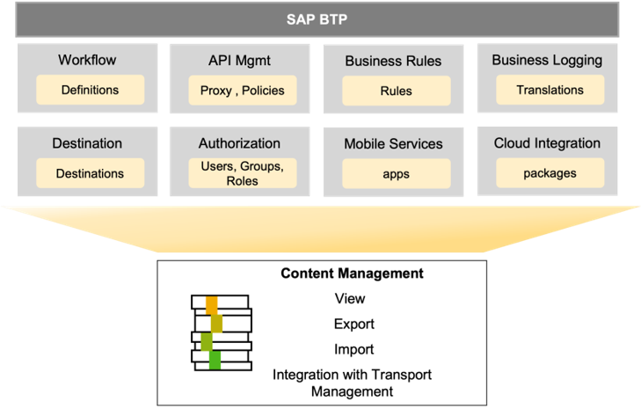
What is CMS (Content Management Service)
A tool that acts as a local agent and operates at sub account level for managing content operations for different SAP BTP services. This service is offered in overall contract with SAP BTP and is auto-entitled.

Slide 7
Setting up CAS
In addition to the SAP BTP BUILD platform, the source tenant also requires an instance of the Content Agent Service (CAS) to work with the CTMS.
The CAS serves as a link between BUILD content and the CTMS, providing the necessary functionality to export and import the content from and to the CTMS.
To set up the CAS in the source tenant, you'll need to create an instance of the Content Agent Service in the subaccount.
You can find detailed information on how to create an instance of the Content Agent Service in the SAP Help page on this link:
https://help.sap.com/docs/CONTENT_AGENT_SERVICE/ae1a4f2d150d468d9ff56e13f9898e07/15406a06dfac4c1fabd7845c703773ba.html.

Slide 8
Create destination to TMS
Once you have created the CAS instance, you'll need to create a new destination with the name "TransportManagementService".
This destination serves as a connection to the CTMS instance. You can create this destination in the SAP BTP Cockpit by navigating to your subaccount and selecting "Destinations" from the left-hand menu. Detailed info can be found here:
https://help.sap.com/docs/CONTENT_AGENT_SERVICE/ae1a4f2d150d468d9ff56e13f9898e07/eed66f35f9d148c8ae5b2d46ff097d8c.html

Slide 9
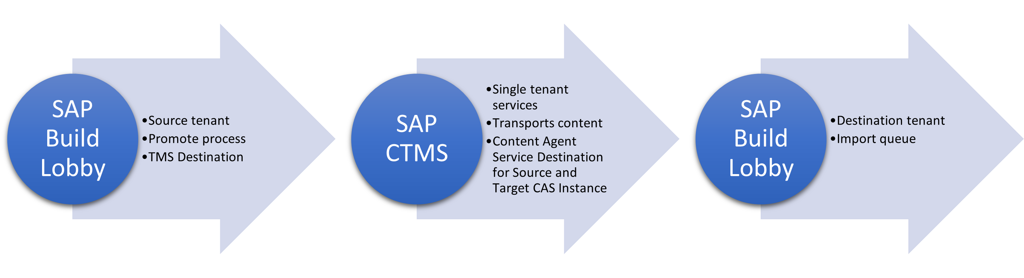
The Process
https://help.sap.com/docs/content-agent-service/user-guide/create-target-node-destination

Slide 10
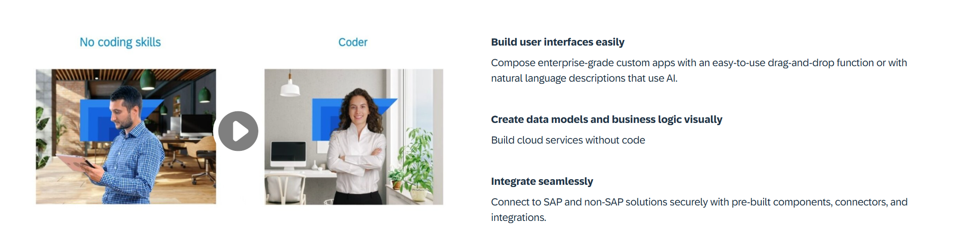
What is Build Apps?
SAP Build Apps is an AI-infused professional application development solution designed for anyone to quickly create apps without code regardless of role or skill level.

Slide 11
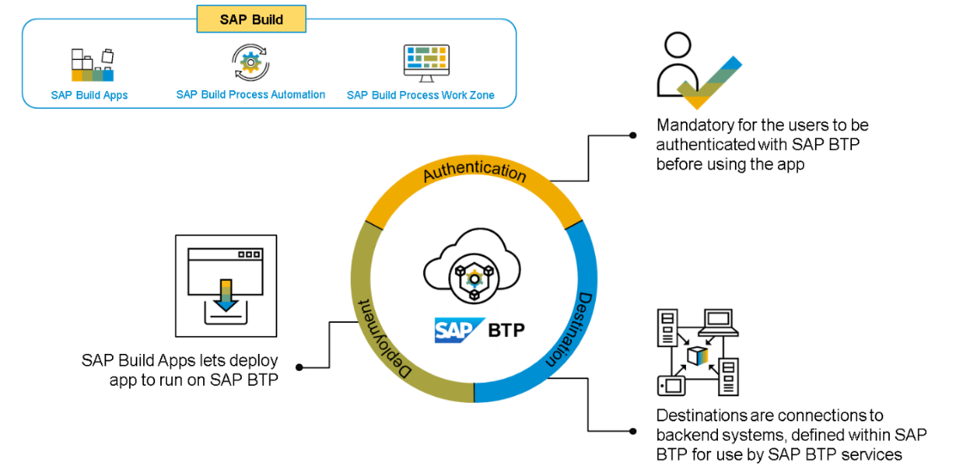
Core Capabilities?
Build Visually – SAP Build Capabilities enable customers to build visually, using drag-and-drop tools and intuitive interfaces. This allows users to quickly and easily design, configure, and deploy applications with no coding. By leveraging the SAP Build capabilities, customers can quickly create rich, interactive applications that streamline business processes, drive greater efficiency, and reduce operational costs. The tools are designed to be easy to use and are backed by a comprehensive library of pre-configured components, integration APIs, and data connectors.
Integrate Seamlessly – SAP Build capabilities help customers integrate their SAP solutions, applications, and systems with each other and with other systems and applications.
Collaborate Effectively – With its feature of seamless integration, SAP Build helps businesses leverage technologies like cloud-based tools with development teams to establish communication protocols like lifecycle management and built-in governance.

Slide 12
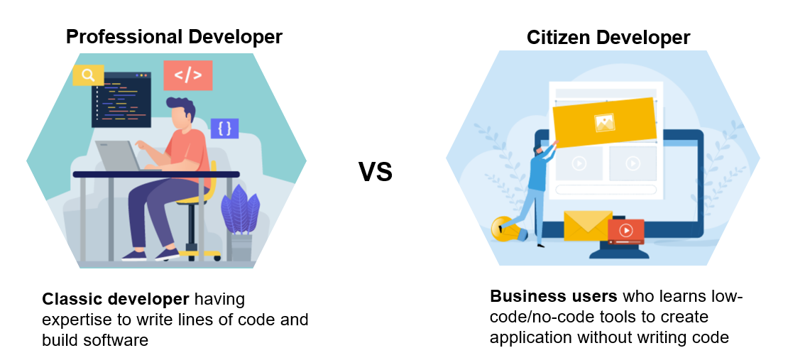
Who is the Build Apps for?

Slide 13
A Quick History
Hybrid App
Fiori Apps can be converted to APK using cordova plugin with WebIDE tool
Medix
Mendix is a low-code platform that allows users to build applications, including those with SAP Fiori UI styling, without extensive coding
2013
2021
2022
SAP UI5
UI5 framework was introduced to design responsive web applications
AppGyver
AppGyver Oy, a pioneer in no-code development platforms that enable users with no coding skills to build applications for Web and mobile uses
SAP Build
Build Apps combining AppGyver, Medix and Build.me prototyping tool
2015
2021

Slide 14
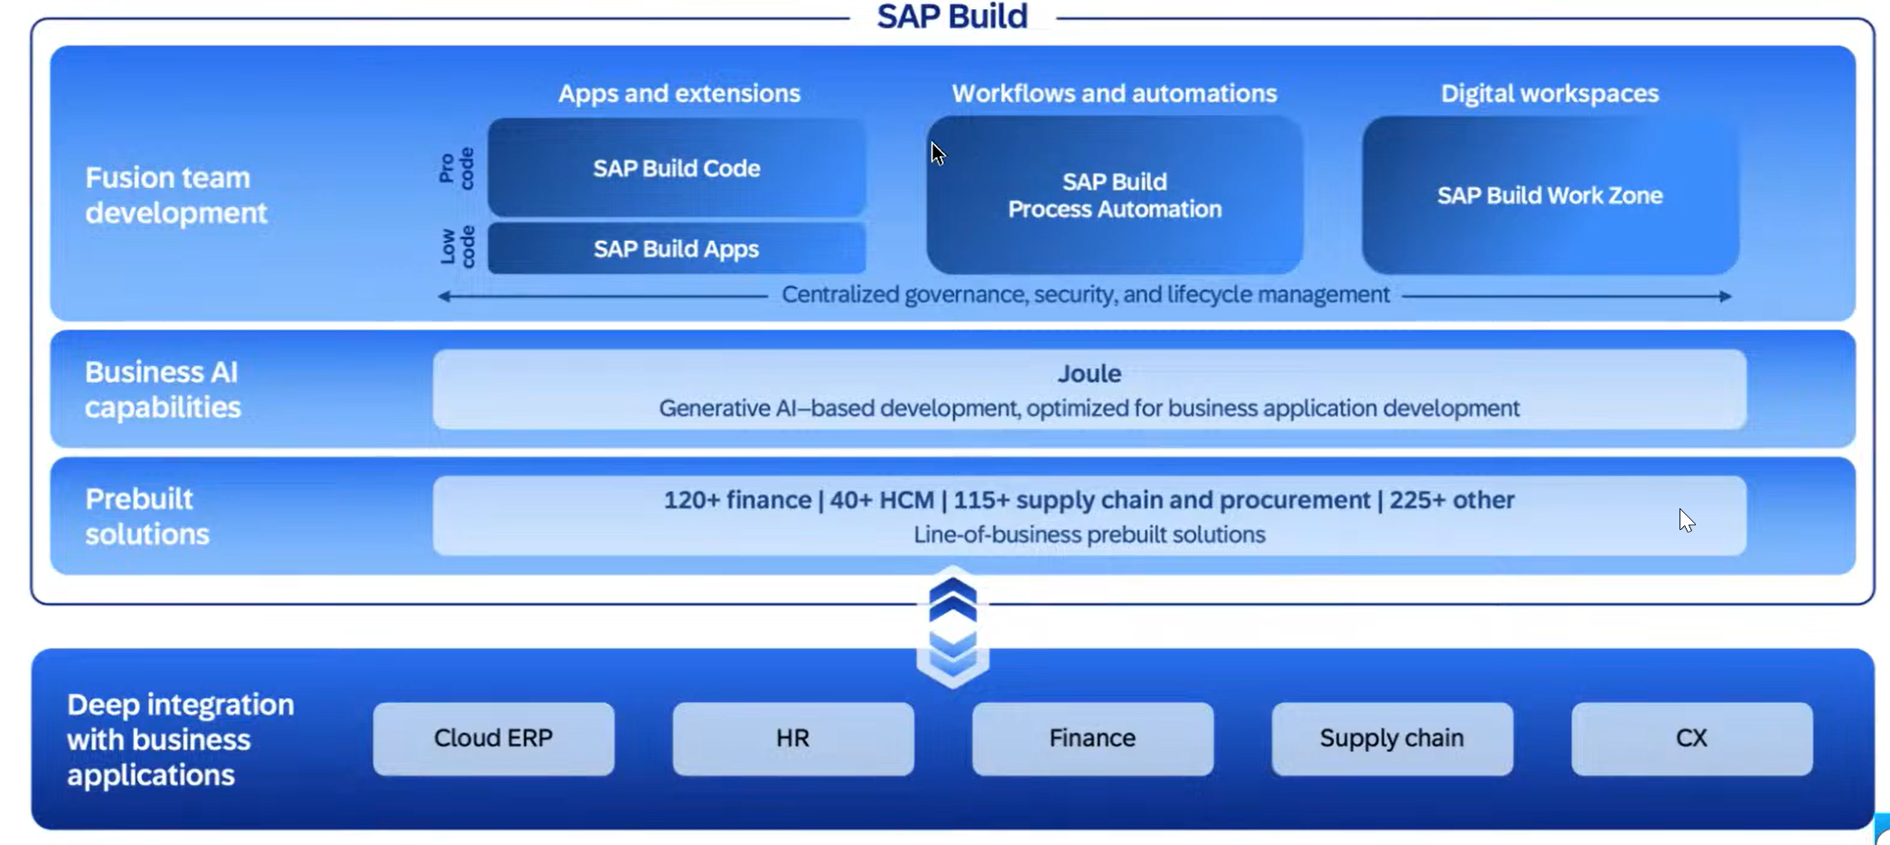
What is SAP Build

Slide 15
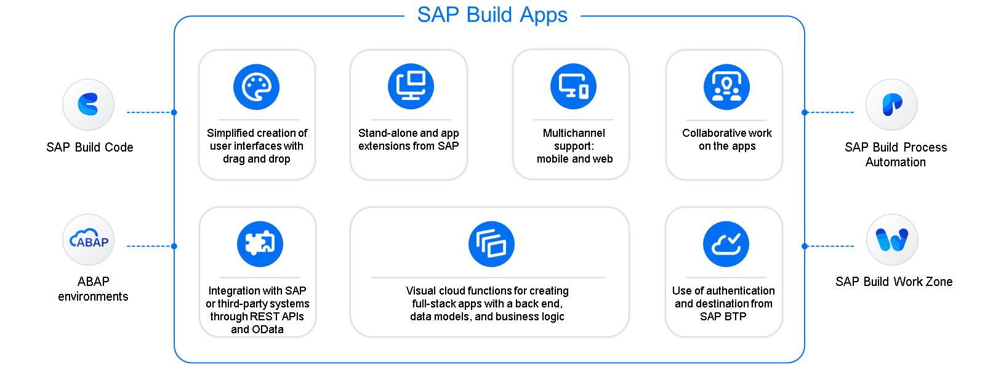
Key Capabilities

Slide 16

What We Did
Let’s Summarize
www.anubhavtrainings.com

Slide 17
www.anubhavtrainings.com
Thank You
End of Day 20
www.anubhavtrainings.com

Slide 18



We’re committed to empower you to be
#FutureReady
through powerful training solutions.
We build the workforce of the future.
250+
Corporate Clients
30,000+
Learners Trained
25000+
Learners Placed
FREE WEBINARS
Sign up for free webinars with industry experts every fortnight!
Enroll Now!
Contact us today!
https://anubhavtrainings.com

